Slide 1






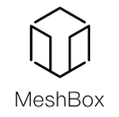
Enterprise Blockchain Developers (Intermediate)
In support of
Powered By

Slide 2
Outline
IPFS React Code Demo
IPFS & IPFS Cluster Concepts
Implementations
© 2017-2020 SmartMesh Foundation Pte. Ltd. | MeshBox Foundation Pte. Ltd.

Slide 3
IPFS
What is IPFS
IPFS is a distributed system for storing and accessing files, websites, applications, and data.
There are three fundamental principles to understand IPFS:
1. Unique identification via content addressing
For Instance: /ipfs/QmXoypizjW3WknFiJnKLwHCnL72vedxjQkDDP1mXWo6uco/wiki/Aardvark.html
Web identify content by where it's located
IPFS uses content addressing to identify content by what's in it.
The hash is unique to the content that it came from, even though it may look short compared to the original content

Slide 4
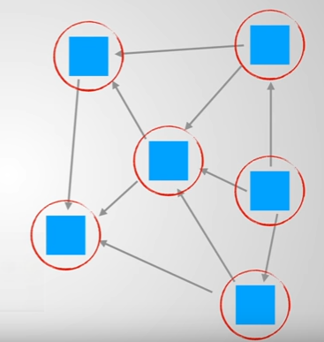
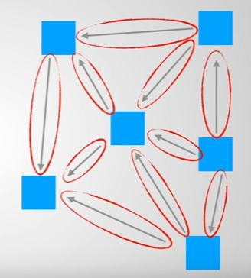
DAG
Content linking via directed acyclic graphs (DAGs)
a directed acyclic graph (DAG ) is a directed graph with no directed cycles. That is, it consists of vertices and edges (also called arcs), with each edge directed from one vertex to another, such that following those directions will never form a closed loop.
Transactions Edges

Slide 5
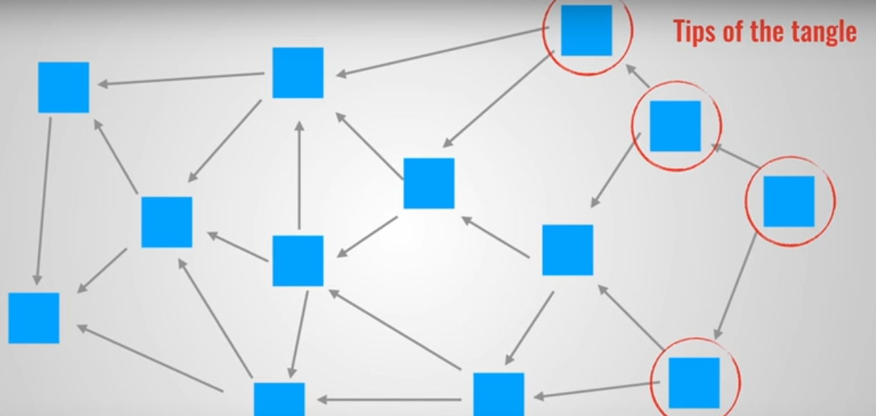
DAG

Slide 6
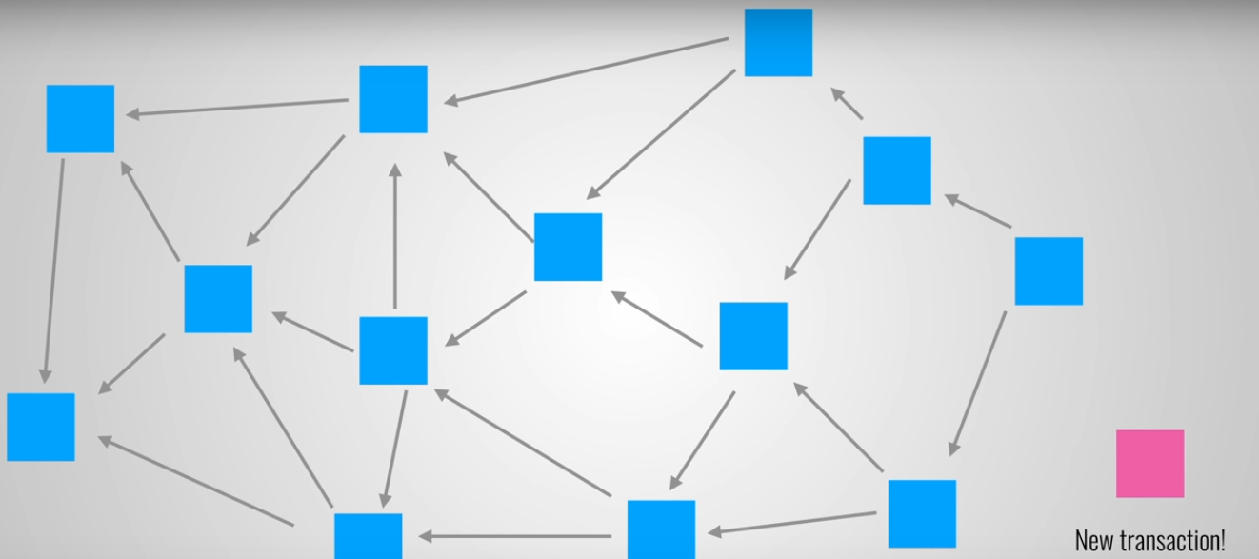
DAG

Slide 7
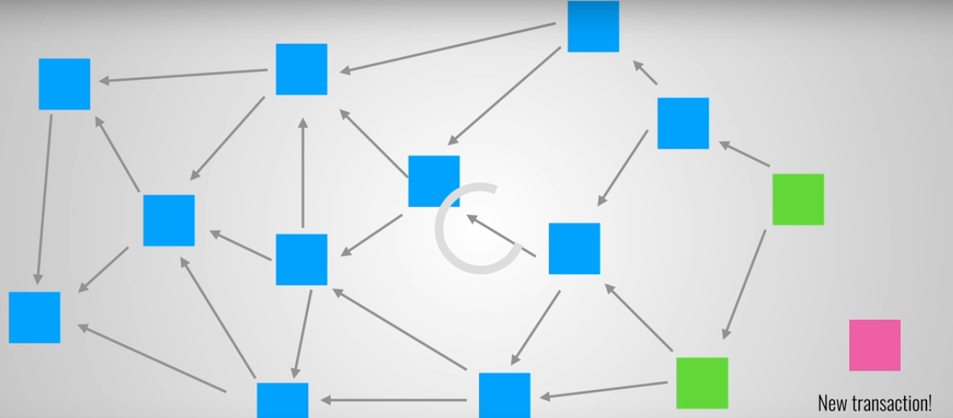
DAG

Slide 8
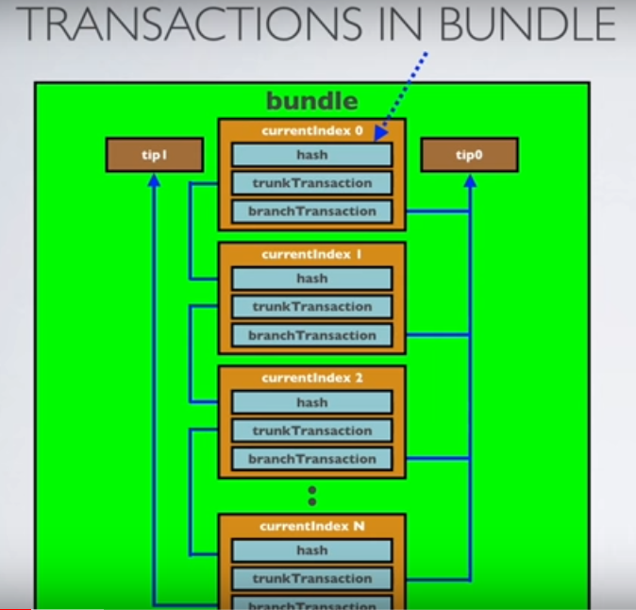
DAG

Slide 9
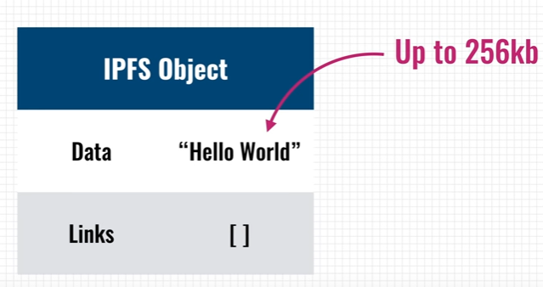
DAG

Slide 10
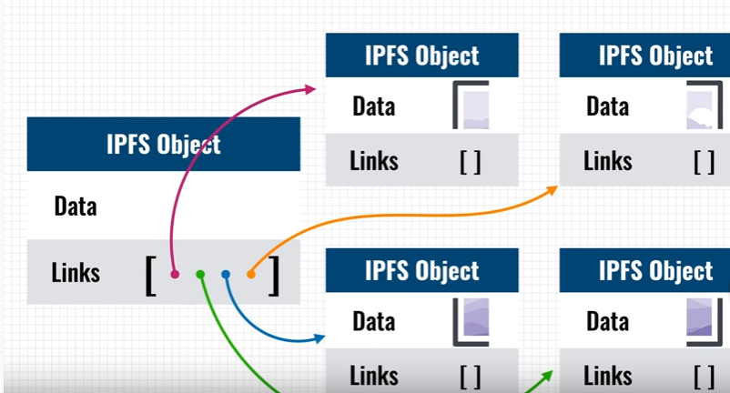
DAG

Slide 11
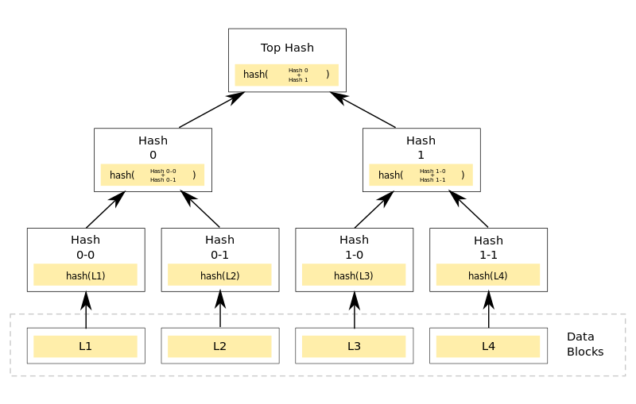
IPFS
Content linking via directed acyclic graphs (DAGs) Merkle DAG
when doing IPFS ADD
Demo: https://dag.ipfs.io/

Slide 12
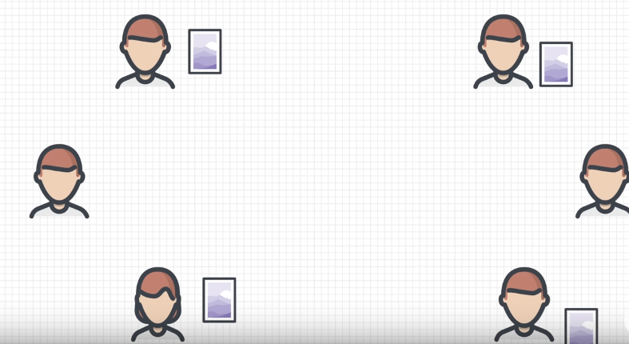
IPFS
Drawback:
if there are only 4 nodes cache the file, and if the went offline, then you will never be able to retrive the file
1 file coin; 2 set up your gateway services

Slide 13
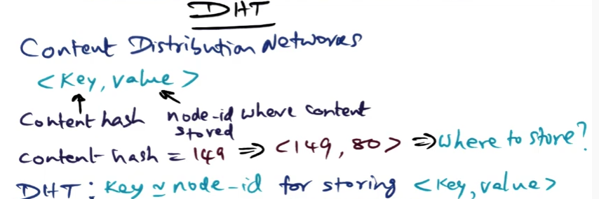

IPFS component
1 Content discovery via distributed hash tables (DHTs)
To find which peers are hosting the content you're after (discovery), IPFS uses a distributed hash table, or DHT
store this hash in the nearest node id

Slide 14
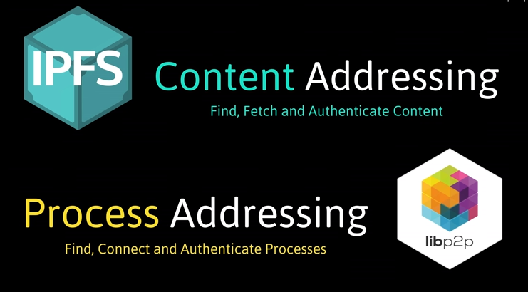
IPFS
2 What makes libp2p especially useful for peer to peer connections is connection multiplexing

Slide 15
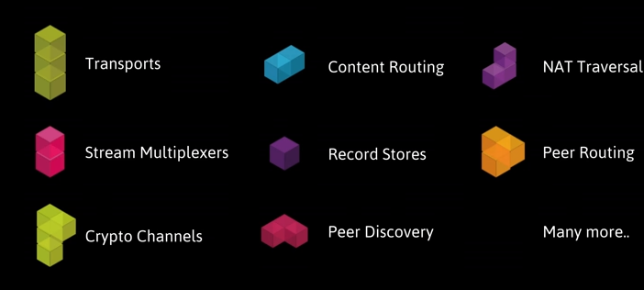
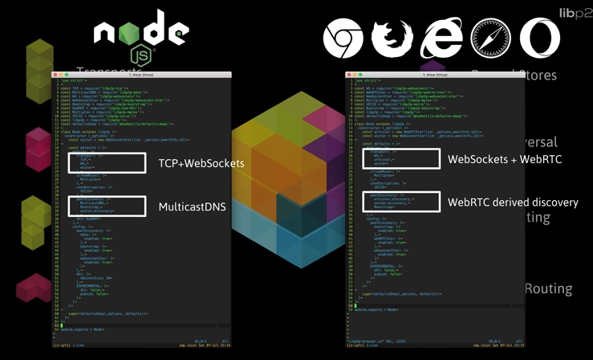
IPFS
2 What makes libp2p especially useful for peer to peer connections is connection multiplexing
all of these protocals can coexist and used in the same application, like api, easy to plug and play

Slide 16
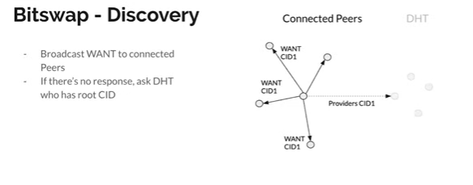
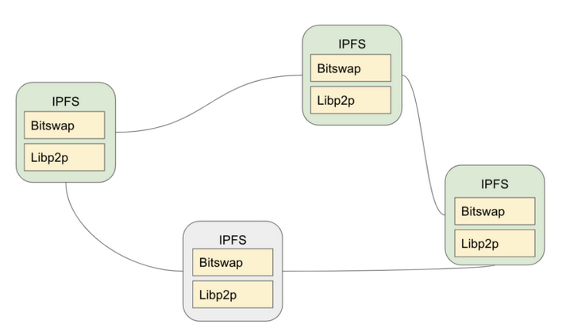
IPFS
3 Bitswap allows you to connect to the peer or peers that have the content you want, send them your wantlist and have them send you the blocks you requested.

Slide 17
IPFS
ipfs pin hash
Pinning is the mechanism that allows you to tell IPFS to always keep a given object somewhere — the default being your local node, though this can be different if you use a third-party remote pinning service.
ipfs pins:
A name in IPNS is the hash of a public key. It is associated with a record containing information about the hash it links to that is signed by the corresponding private key. New records can be signed and published at any time.
host a static website, if there are changes use pins
ipfs name publish /ipfs/QmaMLRsvmDRCezZe2iebcKWtEzKNjBaQfwcu7mcpdm8eY2
> Published to k51qzi5uqu5dkkciu33khkzbcmxtyhn376i1e83tya8kuy7z9euedzyr5nhoew: /ipfs/QmaMLRsvmDRCezZe2iebcKWtEzKNjBaQfwcu7mcpdm8eY2
ipfs add/ ipfs cat

Slide 18
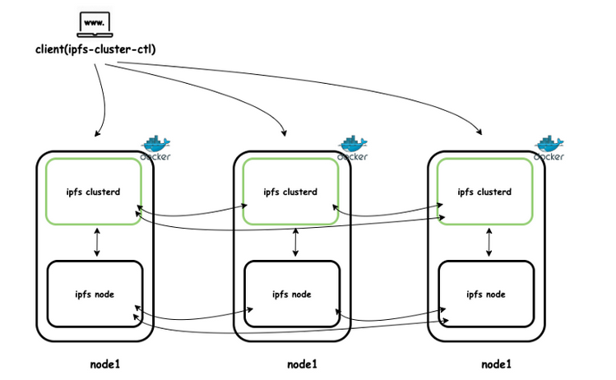
IPFS Cluster
IPFS Cluster: IPFS Cluster provides data orchestration across a swarm of IPFS daemons by allocating, replicating and tracking a global pinset distributed among multiple peers.
Automatic replicating data and pinning across your IPFS network
usage: providing stable data services

Slide 19
IPFS Cluster
How to setup a IPFS cluster (Code Explain)

Slide 20
IPFS Cluster Implementation
IPFS Cluster
how to build your CDN using IPFS cluster?
Step 1:
domain name or a subdomain
Step 2:
a minimum of two servers in different regions. The servers can be dedicated or virtual (IPFS Cluster)
Step 3:
geoDNS tool. With it, a user sending a request to the domain will be directed to the nearest server

Slide 21
IPFS Cluster Implementation
IPFS Cluster
how to build your CND using IPFS cluster?
Here's how geoDNS works:
It gets the client's IP (if they sent the DNS request) or the IP of the recursive DNS server that is used for processing the request. Generally speaking, such recursive servers are usually the DNSs of the Internet providers.
By the client's IP it identifies their country or region. This operation requires the use of GeoIP database, which are available in no short supply. There are even decent free options.
Depending on the client's location, geoDNS returns him the IP address of the closest CDN server.

Slide 22
IPFS Cluster Implementation
IPFS Cluster
how to build your CND using IPFS cluster?
Step 3.1:
Install IPFS Cluster
https://medium.com/rahasak/ipfs-cluster-with-docker-db2ec20a6cc1
(Terraform and Ansible to auto install and manage the cluster)

Slide 23
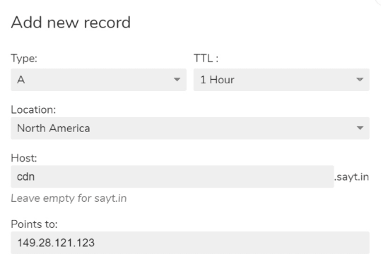
IPFS Cluster Implementation
IPFS Cluster
how to build your CND using IPFS cluster?
Step 3.2:
СlouDNS,Zilore, Amazon Route 53, Cloudflare

Slide 24
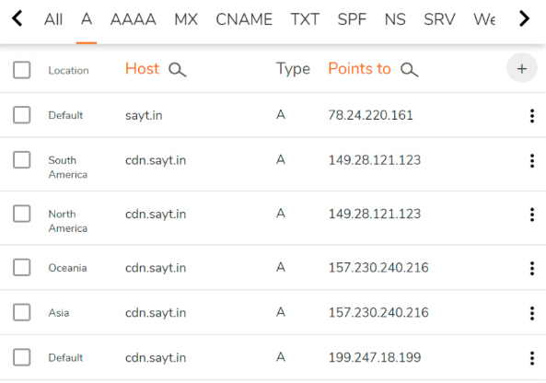
IPFS Cluster Implementation
IPFS Cluster
how to build your CDN using IPFS cluster?
Step 3.1:
СlouDNS,Zilore, Amazon Route 53, Cloudflare

Slide 25
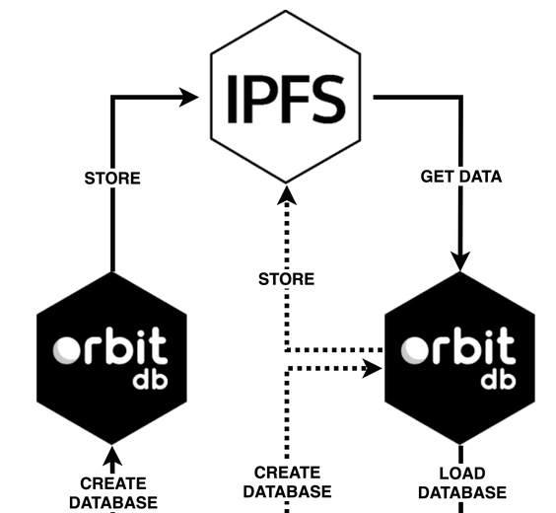
OrbitDB
OrbitDB is a serverless, distributed, peer-to-peer database. OrbitDB uses IPFS as its data storage and IPFS Pubsub to automatically sync databases with peers.

Slide 26
OrbitDB
Data Type:
Key-Value
Log (append-only log)
Feed (same as log database but entries can be removed)
Documents (store indexed JSON documents)
Counters
https://github.com/orbitdb/orbit-db/blob/master/API.md#orbitdbkeyvaluenameaddress
(Code Explain)
OrbitDB (Code Demo)
Integrating to react

Slide 27
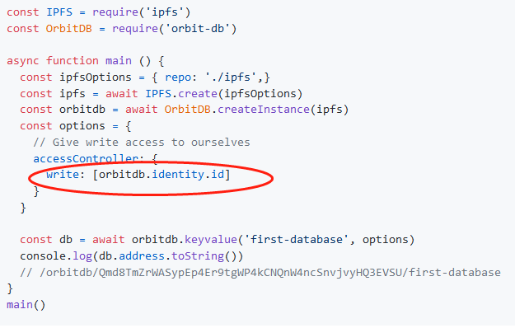
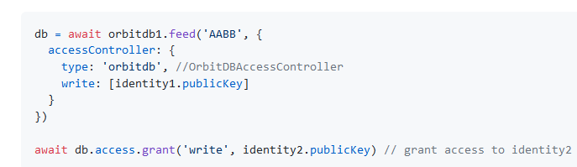
OrbitDB
Features:
1 Identity:
Add Access after db creation

Slide 28
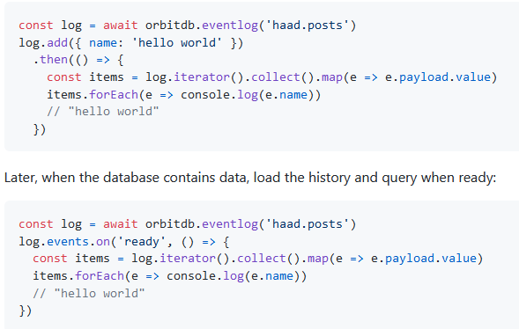
OrbitDB
Features:
2 Event: event and feed

Slide 29
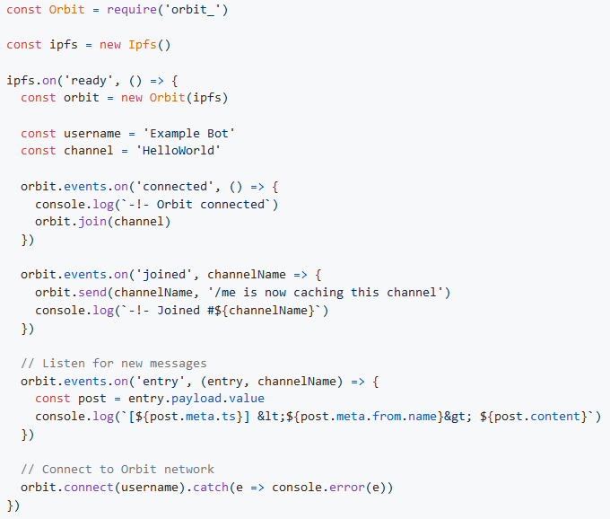
Orbit Core
Orbit is a serverless, distributed, p2p communication library and protocol that enables feed-based information sharing Event: event and feed
https://github.com/orbitdb/orbit-core

Slide 30
Orbit Core
Orbit Core VS Message Queue(kafka)
data permanently stored on IPFS
decentralized message boardcasting solution

Slide 31
Cases
Chatting / Social Media
Marketplace
File Store
CDN
Others

Slide 32

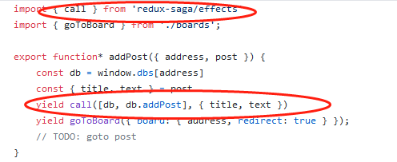
Cases
1 IPFS Board (OrbitDB)
https://github.com/fazo96/ipfs-boards/tree/master/src
BoardStore removed
ipfs-boards/src/orbitdb/index.js
ipfs-boards/src/sagas/posts.js (how to implement)

Slide 33
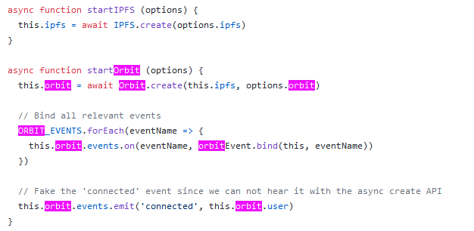
Cases
Orbit Chat (Orbit Core)
https://github.com/orbitdb/orbit-web/blob/d1079653976495e5ae749f1410e11e6af980a6ec/src/workers/network.worker.js
function handleSendTextMessage ({ options }) (implementation)

Slide 34
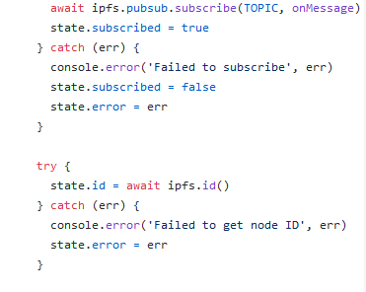
Cases
ipfs-pubsub-chat (pubsub)
https://github.com/tableflip/ipfs-pubsub-chat-example

Slide 35
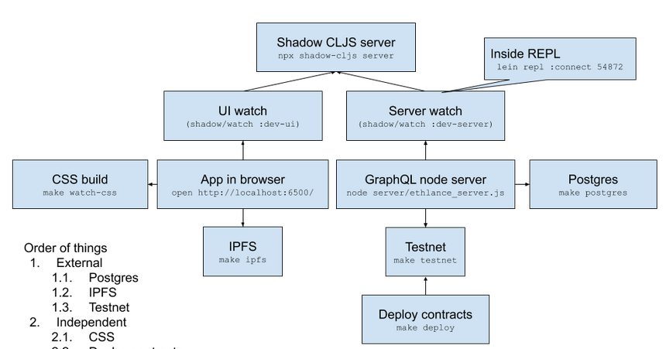
Cases
ethlance
https://github.com/district0x/ethlance

Slide 36
Ansible & TerraForm
TerraForm:
Terraform is a tool for building, changing, and versioning infrastructure safely and efficiently. Terraform can manage existing and popular service providers as well as custom in-house solutions
Example:
https://github.com/mlabouardy/terraform-aws-labs/tree/master/wordpress
User Data
https://www.bogotobogo.com/DevOps/Terraform/Terraform-terraform-userdata.php

Slide 37
Ansible & TerraForm
Ansible
Example:
https://github.com/paralect/ansible-node-sample
one name one command

